Slide 1











BY
Pasindu Mahima
Search . . .
NGATOR
LEARNING
SAD PRESENTATIONS
learn.ngator.com

Slide 2








BY
Pasindu Mahima
Search . . .
IMPORTANT POINTS TO REMEMBER
JAVA GUI COMPONENTS
AND LAYOUTS
BASIC PROCESSES
JAVA LIBRARIES
JAVA DATA STRUCTURES
Java AWT Components
Java Swing Components
Adding data to a Table
Adding items to a Combo Box
MySQL
Jasper Reporting
Arrays
Vectors
HashMap
ACTION LISTENERS
JASPER REPORTING
JFRAME OPERATIONS
SOFTWARE FINALIZING
java.awt.event.*
javax.swing.event.*
java.beans.PropertyChangeEvent
GUI
Components
Creating a report
Sub Reporting
EXIT_ON_CLOSE
DO_NOTHING
DISPOSE
Logger
Unit Testing
jar, exe and setup files

Slide 3
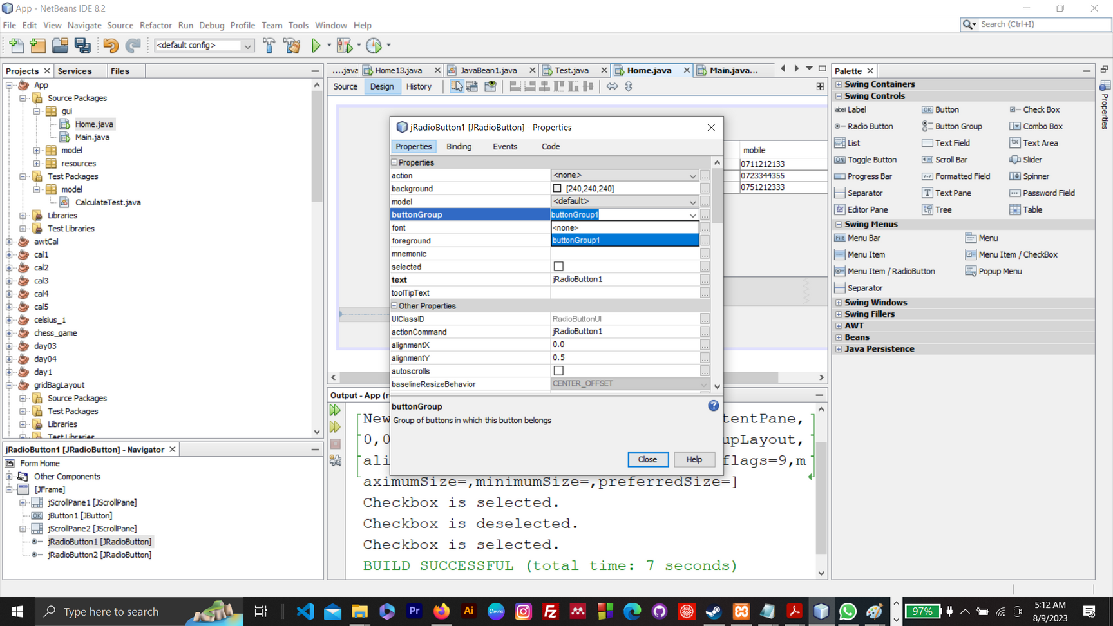
BY
Pasindu Mahima
Search . . .
WHAT ARE THE STEPS TO GROUP JRADIOBUTTONS?
Properties>buttonGroup

Slide 4
BY
Pasindu Mahima
Search . . .
WHAT ARE THE STEPS TO REMOVE BACKGROUND OF A JBUTTON?
Properties>contentAreaFilled>uncheck
Properties>Opaque>uncheck
Properties>Border>No Border

Slide 5
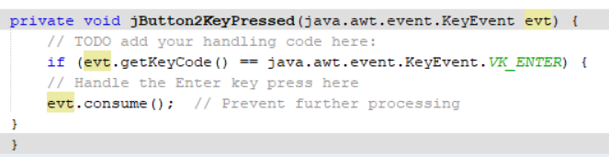
BY
Pasindu Mahima
Search . . .
evt.consume()
By calling evt.consume(), the Enter key press will not be processed by any other key event listeners, and its default behavior will be suppressed.
ex- Here enter key will not be processed

Slide 6
BY
Pasindu Mahima
Search . . .
Drag-and-Drop Events
setDragImage() for Drag-and-Drop Events
setDropSuccess() for Drop Events:
MouseWheel Events
getWheelRotation(): Returns the number of notches the mouse wheel was rotated.
getScrollType(): Returns the type of scrolling that caused the event.

Slide 7
BY
Pasindu Mahima
Search . . .
Hierrachy Events
getChangeFlags(): Returns which components changed.
getChanged(): Returns the last component that was changed.
Component Events
getComponent(): Returns the component that originated the event.

Slide 8
BY
Pasindu Mahima
Search . . .
Item Events
getItem(): Gets the item that was affected by the event.
getStateChange(): Returns the state change (e.g., selected or deselected).
Mouse Event
isPopupTrigger(): Checks if this event is a popup menu trigger event for the platform.

Slide 9
BY
Pasindu Mahima
Search . . .
Window Event
getWindow(): Gets the Window that originated this event.

Slide 10
BY
Pasindu Mahima
Search . . .
USEFUL KEYWORDS AND FILE EXTENSIONS
JAR file - Java Archive file
Exe File - Executable File
MSI file - Microsoft Installer File
JDK - Java Development Kit
JRE - Java Runtime Environment
JRXML - Jasper Reporting Extensible Markup Language
Jasper File - File compiled by Jasper Software
DMG File - Disk Image File / a mountable disk image / Apple Disk Image file extension

Slide 11

BY
Pasindu Mahima
Search . . .
THANK YOU
Social Profiles
Follow Ngator on social networks
Facebook : https://www.facebook.com/learnwithngator
Instagram :https://www.instagram.com/mahimapasindu/
GitHub : https://github.com/drgnhunter
LinkedIn : https://www.linkedin.com/in/pasindu-mahima-3a0031187/
END SLIDE

